Slide 1
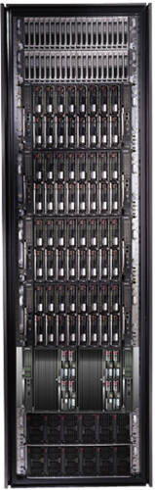
Cluster Computing with DryadLINQ
Mihai Budiu
Microsoft Research, Silicon Valley
SJSU Cloud Computing Course September 13, 2010

Slide 2

Lessons to remember
Will use this symbol throughout the presentation to point out general lessons learned.

Slide 3

Goal
Notes:
Enable any programmer to write and run applications on small and large computer clusters.

Slide 4
Design Space
Grid
Internet
Data-
parallel
Search
Dryad
Shared
memory
Data
center
Transaction
HPC
Latency
(interactive)
Throughput
(batch)
Notes:
Dryad is optimized for: throughput, data-parallel computation, in a private data-center.

Slide 5
Software Stack
Applications
DryadLINQ
Dryad
Cluster storage
Cluster services
Autopilot
Windows Server
Windows Server
Windows Server
Windows Server

Slide 6
“What’s the point if I can’t have it?”
Dryad+DryadLINQ available for download
Academic license or
Commercial evaluation license
Windows HPC platform
DryadLINQ available with source code
http://connect.microsoft.com/site/sitehome.aspx?SiteID=891
To be offered as a commercial product soon by
Windows HPC
Windows Azure

Slide 7
Data-Parallel Computation
Application
SQL
Sawzall, Java
≈SQL
LINQ, SQL
Parallel Databases
Sawzall,FlumeJava
Pig, Hive
DryadLINQ Scope
Language
Map-Reduce
Hadoop
Dryad
Execution
GFS BigTable
HDFS
S3
Cosmos
Azure SQL Server
Storage

Slide 8
Modularity pays off
Entire stack easily ported to new runtimes
HPC, Cosmos, Azure
Clean language/runtime separation
Allowed new languages to reuse stack: Scope, DryadLINQ
“Hourglass” software stack shape
Isolates software layers

Slide 9
Cluster ArchitecTURE
Applications
DryadLINQ
Dryad
Cluster storage
Cluster services
Autopilot
Windows Server
Windows Server
Windows Server
Windows Server

Slide 10
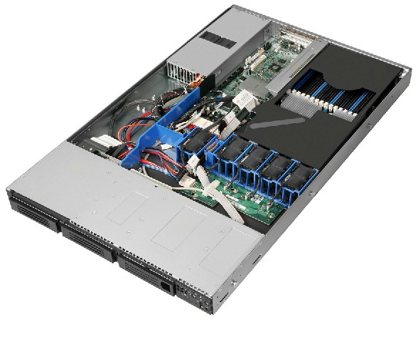
Cluster Machines
Commodity server-class systems
Optimized for cost
Remote management interface
Local storage (multiple drives)
Multi-core CPU
Gigabit Ethernet
Stock Windows Server

Slide 11
Cluster network topology
To next level switch
top-level switch
top-of-rack switch
rack

Slide 12
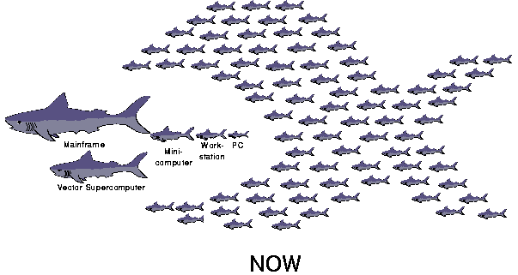
The secret of scalability
Cheap hardware
Smart software
Berkeley Network of Workstations (’94-’98) http://now.cs.berkeley.edu

Slide 13
Autopilot
Applications
DryadLINQ
Dryad
Cluster storage
Cluster services
Autopilot
Windows Server
Windows Server
Windows Server
Windows Server

Slide 14


Autopilot goal
Handle automatically routine tasks
Without operator intervention

Slide 15

Autopiloted System
Autopilot control
Application
Autopilot services

Slide 16
Recovery-Oriented Computing
Everything will eventually fail
Design for failure
Crash-only software design
http://roc.cs.berkeley.edu
Brown, A. and D. A. Patterson. Embracing Failure: A Case for Recovery-Oriented Computing (ROC). High Performance Transaction Processing Symposium, October 2001.

Slide 17

Autopilot Architecture
Discover new machines; netboot; self-test
Install application binaries and configurations
Monitor application health
Fix broken machines
Operational data collection and visualization
Provisioning
Deployment
Watchdog
Repair
Device Manager

Slide 18
Centralized Replicated Control
Keep essential control state centralized
Replicate the state for reliability
Use the Paxos consensus protocol
Leslie Lamport. The part-time parliament. ACM Transactions on Computer Systems, 16(2):133{169, May 1998.
Paxos

Slide 19


Consistency Model
Strong consistency
Expensive to provide
Hard to build right
Easy to understand
Easy to program against
Simple application design
Weak consistency
Increases availability
Many different models
Easy to misuse
Very hard to understand
Conflict management in application

Slide 20
Autopilot abstraction
Self-healing machines
Autopilot
Windows Server
Windows Server
Windows Server
Windows Server

Slide 21
Cluster Services
Applications
DryadLINQ
Dryad
Cluster storage
Cluster services
Autopilot
Windows Server
Windows Server
Windows Server
Windows Server

Slide 22
Cluster Machines
Remote execution
Storage
Remote execution
Storage
Autopilot services manager
Autopilot services manager
Storage metadata service
Name service
Scheduling
Paxos
Autopilot services manager
Autopilot services manager
Autopilot services manager
Autopilot services manager
Autopilot services manager

Slide 23
Cluster Services
Name service: discover cluster machines
Scheduling: allocate cluster machines
Storage metadata: distributed file location
Storage: distributed file contents
Remote execution: spawn new computations

Slide 24
Cluster services abstraction
Reliable specialized machines
Cluster services
Autopilot
Windows Server
Windows Server
Windows Server
Windows Server

Slide 25

Layered Software Architecture
Simple components
Software-provided reliability
Versioned APIs
Design for live staged deployment
Redesign a broken API, do not just “fix” it (if there are no external dependences)

Slide 26
Cluster STorage
Applications
DryadLINQ
Dryad
Cluster storage
Cluster services
Autopilot
Windows Server
Windows Server
Windows Server
Windows Server

Slide 27
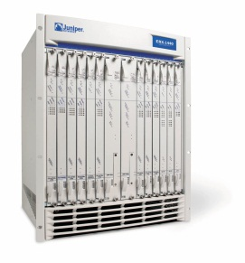
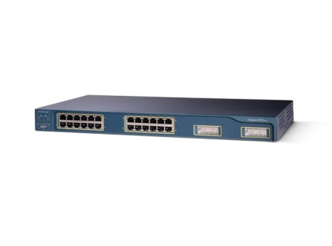
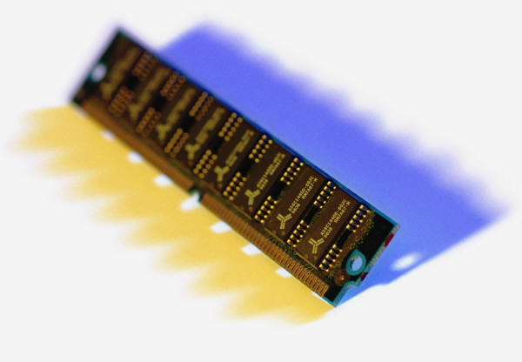
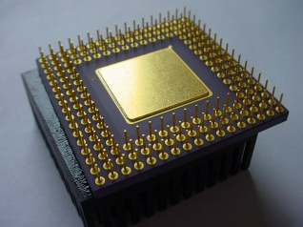
Bandwidth hierarchy
Cache
RAM
Local disks
Local rack
Remote rack
Remote
datacenter

Slide 28
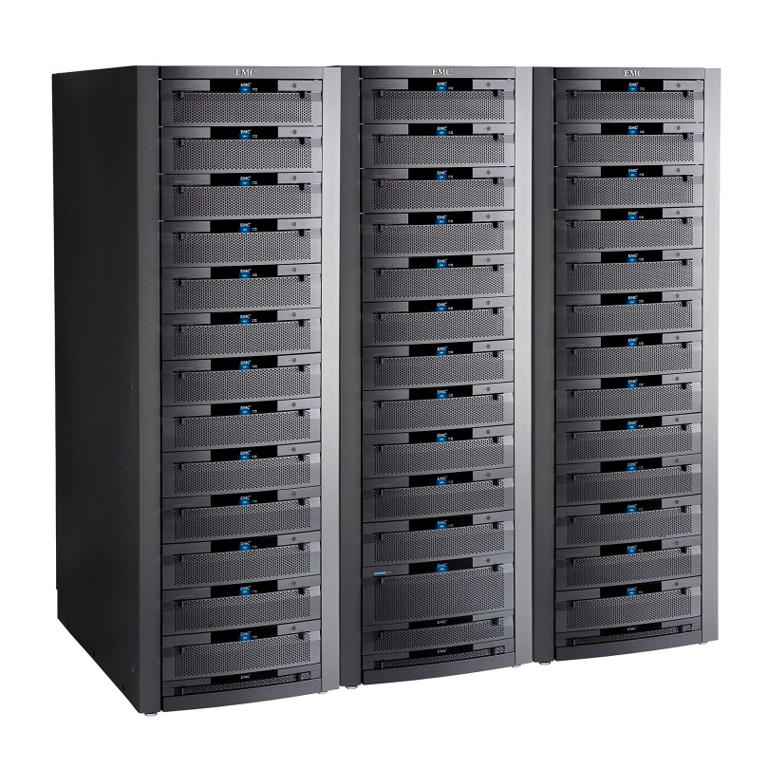
Storage bandwidth
Expensive
Fast network needed
Limited by network b/w
SAN
Cheap network
Cheap machines
Limited by disk b/w
JBOD

Slide 29
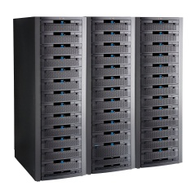
Time to read 1TB (sequential)
1 TB / 50MB/s = 6 hours
1 TB / 10 Gbps = 40 minutes
1 TB / (50 MB/s/disk x 10000 disks) = 2s
(1000 machines x 10 disks x 1TB/disk = 10PB)

Slide 30
Large-scale Distributed Storage
F[1]
File F
F[0]
F[1]
F[0]
Storage metadata service
Storage
Storage
Storage

Slide 31
Parallel Application I/O
App ctrl
App
App
lookup
File F
F[0]
F[1]
Storage metadata service
Storage
Storage
Storage

Slide 32
Cluster Storage Abstraction
Set of reliable machines with a global filesystem
Cluster storage
Cluster services
Autopilot
Windows Server
Windows Server
Windows Server
Windows Server

Slide 33
DRYAD
Applications
DryadLINQ
Dryad
Cluster storage
Cluster services
Autopilot
Windows Server
Windows Server
Windows Server
Windows Server

Slide 34

Dryad
Continuously deployed since 2006
Running on >> 10⁴ machines
Sifting through > 10Pb data daily
Runs on clusters > 3000 machines
Handles jobs with > 10⁵ processes each
Platform for rich software ecosystem
Used by >> 100 developers
Written at Microsoft Research, Silicon Valley
The Dryad by Evelyn De Morgan.

Slide 35
Dryad = Execution Layer
Job (application)
Pipeline
≈
Dryad
Shell
Cluster
Machine
Notes:
In the same way as the Unix shell does not understand the pipeline running on top, but manages its execution (i.e., killing processes when one exits), Dryad does not understand the job running on top.

Slide 36
2-D Piping
Unix Pipes: 1-D
grep | sed | sort | awk | perl
Dryad: 2-D
grep¹⁰⁰⁰ | sed⁵⁰⁰ | sort¹⁰⁰⁰ | awk⁵⁰⁰ | perl⁵⁰
Notes:
Dryad is a generalization of the Unix piping mechanism: instead of uni-dimensional (chain) pipelines, it provides two-dimensional pipelines. The unit is still a process connected by a point-to-point channel, but the processes are replicated.

Slide 37
Virtualized 2-D Pipelines
Notes:
This is a possible schedule of a Dryad job using 2 machines.

Slide 38

Virtualized 2-D Pipelines

Slide 39

Virtualized 2-D Pipelines

Slide 40
Virtualized 2-D Pipelines

Slide 41
Virtualized 2-D Pipelines
2D DAG
multi-machine
virtualized
Notes:
The Unix pipeline is generalized 3-ways:
2D instead of 1D
spans multiple machines
resources are virtualized: you can run the same large job on many or few machines

Slide 42
Dryad Job Structure
Channels
Input files
Stage
Output files
grep
sort
awk
sed
perl
grep
sort
sed
awk
grep
sort
Vertices (processes)
Notes:
This is the basic Dryad terminology.

Slide 43
Channels
Finite streams of items
distributed filesystem files (persistent)
SMB/NTFS files (temporary)
TCP pipes (inter-machine)
memory FIFOs (intra-machine)
X
Items
M
Notes:
Channels are very abstract, enabling a variety of transport mechanisms.
The performance and fault-tolerance of these machanisms vary widely.

Slide 44
Dryad System Architecture
data plane
Files, TCP, FIFO, Network
job schedule
V
V
V
NS, Sched
RE
RE
RE
control plane
Job manager
cluster
Notes:
The brain of a Dryad job is a centralized Job Manager, which maintains a complete state of the job.
The JM controls the processes running on a cluster, but never exchanges data with them.
(The data plane is completely separated from the control plane.)

Slide 45
Separate Data and Control Plane
Different kinds of traffic
Data = bulk, pipelined
Control = interactive
Different reliability needs

Slide 46
Centralized control
JM state is not replicated
Entire JM state is held in RAM
Simple implementation
Vertices use leases: no runaway computations on JM crash
JM crash causes complete job crash

Slide 47

Staging
1. Build
2. Send .exe
7. Serialize vertices
vertex code
Remote execution
service
5. Generate graph
JM code
Name server
6. Initialize vertices
3. Start JM
8. Monitor
Vertex execution
4. Query cluster resources
Notes:
Computation Staging

Slide 48
Scaling Factors
Understand how fast things scale
# machines << # vertices << # channels
# control bytes << # data bytes
Understand the algorithm cost
O(# machines²) acceptable, but O(# edges²) not
Every order-of-magnitude increase will reveal new bugs

Slide 49



Fault Tolerance
Notes:
Vertex failures and channel failures are handled differently.

Slide 50
Danger of Fault Tolerance
Fault tolerance can mask defects in other software layers
Log fault repairs
Review the logs periodically

Slide 51
Dryad Abstraction
Reliable machine running distributed jobs with “infinite” resources
Dryad
Cluster storage
Cluster services
Autopilot
Windows Server
Windows Server
Windows Server
Windows Server

Slide 52
Policy Managers
R
R
R
R
Stage R
Connection R-X
X
X
X
X
Stage X
X Manager
R manager
R-X Manager
Job
Manager

Slide 53
Dynamic Graph Rewriting
X[0]
X[1]
X[3]
X[2]
X’[2]
Slow vertex
Duplicate vertex
Completed vertices
Duplication Policy = f(running times, data volumes)
Notes:
The handling of apparently very slow computation by duplication of vertices is handled by a stage manager.

Slide 54
Failures
Fail-stop (crash) failures are easiest to handle
Many other kinds of failures possible
Very slow progress
Byzantine (malicious) failures
Network partitions
Understand the failure model for your system
probability of each kind of failure
validate the failure model (measurements)

Slide 55
Dynamic Aggregation
S
S
S
S
S
S
T
static
S
S
S
S
S
S
# 1
# 2
# 1
# 3
# 3
# 2
rack #
A
A
A
# 1
# 2
# 3
dynamic
T
Notes:
Aggregating data with associative operators can be done in a bandwidth-preserving fashion in the intermediate aggregations are placed close to the source data.

Slide 56
Separate policy and mechanism
Implement a powerful and generic mechanism
Leave policy to the application layer
Trade-off in policy language: power vs. simplicity

Slide 57
Policy vs. Mechanism
Application-level
Most complex in C++ code
Invoked with upcalls
Need good default implementations
DryadLINQ provides a comprehensive set
Built-in
Scheduling
Graph rewriting
Fault tolerance
Statistics and reporting

Slide 58
DRYADLINQ
Applications
DryadLINQ
Dryad
Cluster storage
Cluster services
Autopilot
Windows Server
Windows Server
Windows Server
Windows Server

Slide 59

LINQ
=> DryadLINQ
Dryad
Notes:
DryadLINQ adds a wealth of features on top of plain Dryad.

Slide 60
LINQ = .Net+ Queries
Collection<T> collection;
bool IsLegal(Key);
string Hash(Key);
var results = from c in collection where IsLegal(c.key) select new { Hash(c.key), c.value};
Notes:
Language Integrated Query is an extension of .Net which allows one to write declarative computations on collections (green part).

Slide 61
Collections and Iterators
class Collection<T> : IEnumerable<T>;
Iterator
(current element)
Elements of type T

Slide 62

DryadLINQ Data Model
.Net objects
Partition
Collection

Slide 63

DryadLINQ = LINQ + Dryad
Collection<T> collection;
bool IsLegal(Key k);
string Hash(Key);
var results = from c in collection where IsLegal(c.key) select new { Hash(c.key), c.value};
Vertex code
Query plan
(Dryad job)
Data
collection
C#
C#
C#
C#
results
Notes:
DryadLINQ translates LINQ programs into Dryad computations:
- C# and LINQ data objects become distributed partitioned files.
- LINQ queries become distributed Dryad jobs.
- C# methods become code running on the vertices of a Dryad job.

Slide 64
DryadLINQ Abstraction
.Net with “infinite” resources
DryadLINQ
Dryad
Cluster storage
Cluster services
Autopilot
Windows Server
Windows Server
Windows Server
Windows Server

Slide 65
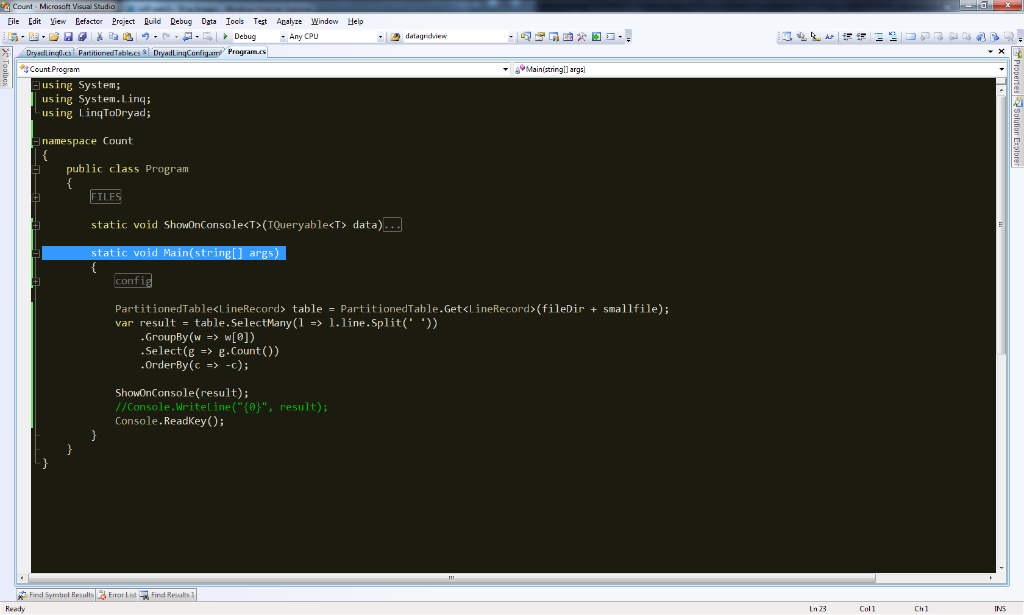
Demo

Slide 66
Example: Histogram
public static IQueryable<Pair> Histogram(
IQueryable<LineRecord> input, int k)
{
var words = input.SelectMany(x => x.line.Split(' '));
var groups = words.GroupBy(x => x);
var counts = groups.Select(x => new Pair(x.Key, x.Count()));
var ordered = counts.OrderByDescending(x => x.count);
var top = ordered.Take(k);
return top;
}
“A line of words of wisdom”
[“A”, “line”, “of”, “words”, “of”, “wisdom”]
[[“A”], [“line”], [“of”, “of”], [“words”], [“wisdom”]]
[ {“A”, 1}, {“line”, 1}, {“of”, 2}, {“words”, 1}, {“wisdom”, 1}]
[{“of”, 2}, {“A”, 1}, {“line”, 1}, {“words”, 1}, {“wisdom”, 1}]
[{“of”, 2}, {“A”, 1}, {“line”, 1}]

Slide 67
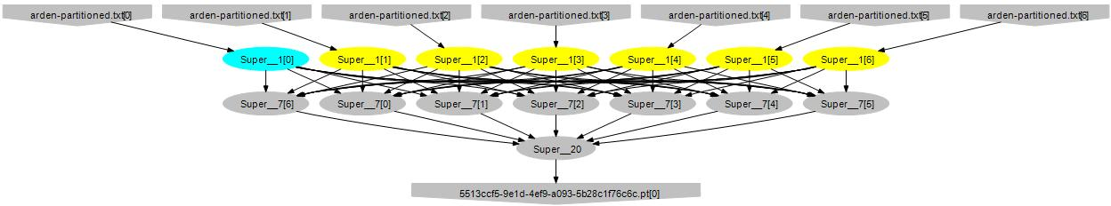
Histogram Plan
SelectMany
Sort
GroupBy+Select
HashDistribute
MergeSort
GroupBy
Select
Sort
Take
MergeSort
Take

Slide 68
Map-Reduce in DryadLINQ
public static IQueryable<S> MapReduce<T,M,K,S>(
this IQueryable<T> input,
Func<T, IEnumerable<M>> mapper,
Func<M,K> keySelector,
Func<IGrouping<K,M>,S> reducer)
{
var map = input.SelectMany(mapper);
var group = map.GroupBy(keySelector);
var result = group.Select(reducer);
return result;
}

Slide 69
Map-Reduce Plan
M
M
M
M
M
M
M
map
Q
Q
Q
Q
Q
Q
Q
sort
G₁
G₁
G₁
G₁
G₁
G₁
G₁
groupby
map
M
R
R
R
R
R
R
R
reduce
D
D
D
D
D
D
D
distribute
G
R
MS
MS
MS
MS
MS
mergesort
groupby
X
G₂
G₂
G₂
G₂
G₂
partial aggregation
R
R
R
R
R
reduce
X
X
X
MS
MS
mergesort
static
dynamic
dynamic
G₂
G₂
groupby
reduce
S
S
S
S
S
S
R
R
reduce
A
A
A
X
X
consumer
T

Slide 70
Distributed Sorting Plan
DS
DS
DS
DS
DS
H
H
H
O
D
D
D
D
D
static
dynamic
dynamic
M
M
M
M
M
S
S
S
S
S

Slide 71
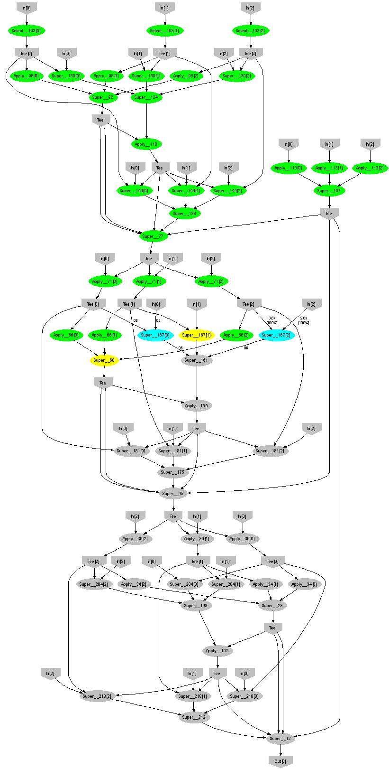
Expectation Maximization
160 lines
3 iterations shown
Notes:
More complicated, even iterative algorithms, can be implemented.

Slide 72
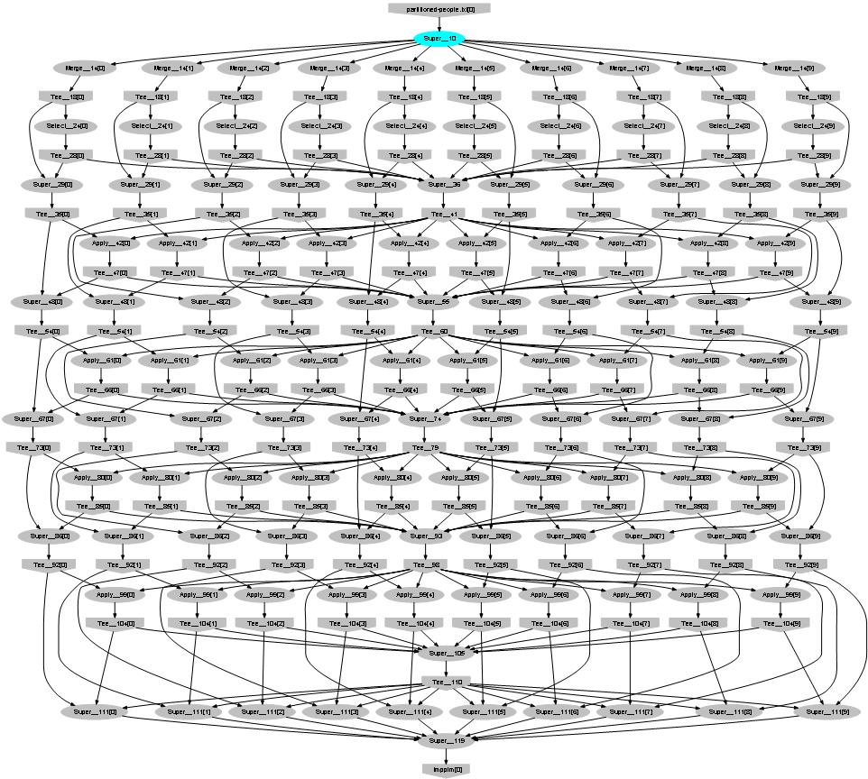
Probabilistic Index Maps
Images
features

Slide 73
Language Summary
Where
Select
GroupBy
OrderBy
Aggregate
Join

Slide 74
Exercises
Sketch LINQ queries for the following problems computing on a collection of numbers:
Keep all numbers divisible by 5
The average value
The median value
Normalize the numbers to have a mean value of 0
Keep each number only once
The average of all even #s and of all odd #s
The most frequent value
The number of distinct positive values
The values that are also found in a second collection

Slide 75
Solutions (1)
Keep all numbers divisible by 5
var div = x.Where(v => v % 5 == 0);
The average value
var avg = x.Sum() / x.Count();
The median value
var median = x.Take(x.Count() / 2).Last();
Normalize the numbers to have a mean value of 0
var norm = x.Select(v => v - avg);
Keep each number only once
var uniq = x.GroupBy(v => v) .Select(g => g.Key);
var uniq = x.Distinct();

Slide 76
Solutions (2)
The average of all even #s and of all odd #s var avgs = x.GroupBy(v => v % 2) .Select(g => g.Sum() / g.Count());
The most frequent value var freq = x.GroupBy(v => v) .OrderBy(g => g.Count()) .Take(1) .Select(g => g.Key);
The number of distinct positive values var pos = x.Where(v => v >= 0) .GroupBy(v => v) .Select(g => g.Key) .Count();
The values that are also found in a second collection var common = x.Distinct() .Join(norm.Distinct(), v => v, v => v, (v1, v2) => v1);

Slide 77
LINQ System Architecture
Local machine
Execution engine
LINQ-to-obj
PLINQ
LINQ-to-SQL
LINQ-to-WS
DryadLINQ
Flickr
Oracle
LINQ-to-XML
Your own
.Net program
LINQ Provider
Query
Objects

Slide 78
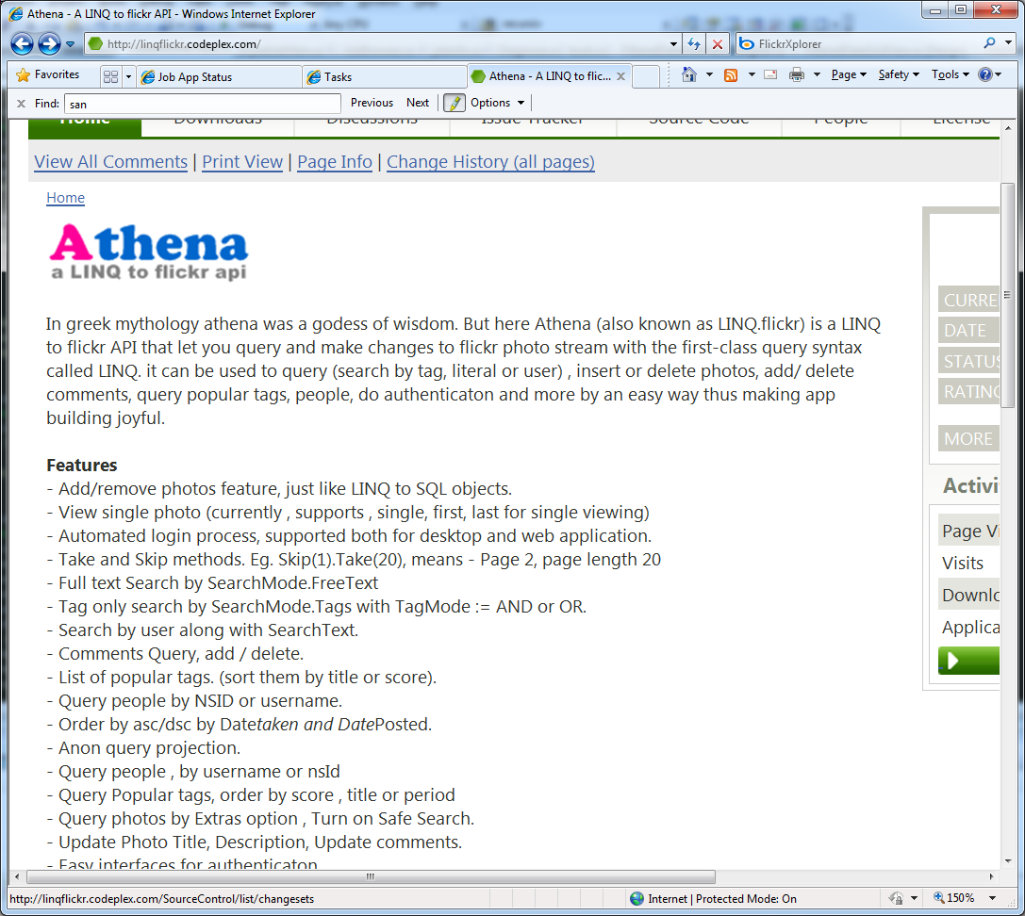
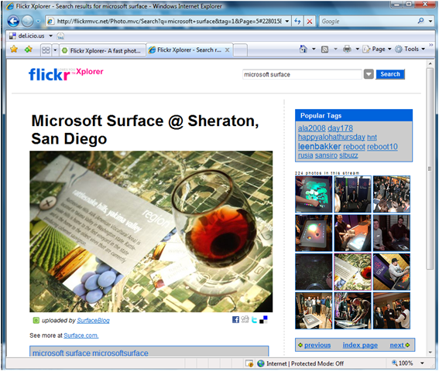
Aside: Linq to Flickr
Operates on collections of images
Executes on local machine & flickr
Another illustration of the power of LINQ

Slide 79
The DryadLINQ Provider
Client machine
.Net
DryadLINQ
Data center
Distributed query plan
Query Expr
Invoke
Query
Vertex code
Con- text
Input Tables
ToCollection
Dryad JM
Dryad Execution
.Net Objects
Output Table
iterator
Results
foreach
Output Tables

Slide 80
Combining Query Providers
Local machine
Execution engines
.Net program
(C#, VB, F#, etc)
LINQ Provider
PLINQ
Query
LINQ Provider
SQL Server
LINQ Provider
DryadLINQ
Objects
LINQ Provider
LINQ-to-obj

Slide 81
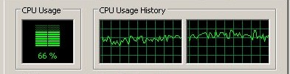
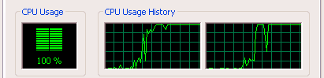
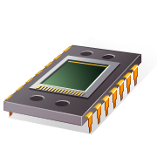
Using PLINQ
Query
DryadLINQ
Local query
PLINQ
Notes:
At the bottom DryadLINQ uses LINQ to run the computation in parallel on multiple cores.

Slide 82


Using LINQ to SQL Server
Query
DryadLINQ
Query
Query
Query
LINQ to SQL
LINQ to SQL
Query
Query

Slide 83
Using LINQ-to-objects
Local machine
LINQ to obj
debug
Query
production
DryadLINQ
Cluster

Slide 84

LINQ Design
Strong typing for data very useful
Automatic serialization
Detect complex bugs
LINQ extensibility is very powerful
Running on very different runtimes
Managed code increases productivity by 10x10

Slide 85
More Tricks of the trade
Asynchronous operations hide latency
Management using distributed state machines
Logging state transitions for debugging
Compression trades-off bandwidth for CPU

Slide 86
BUILDING ON DRYADLINQ
Applications
DryadLINQ
Dryad
Cluster storage
Cluster services
Autopilot
Windows Server
Windows Server
Windows Server
Windows Server

Slide 87
Debugging, Profiling, Monitoring
Visualization
Plug-ins
Statistics
Job
browser
Cluster
browser
Log collection
Debug, profile, instrument, diagnose
DryadLINQ
DB
DryadLINQ job object model
Cosmos Cluster
HPC
Cluster

Slide 88
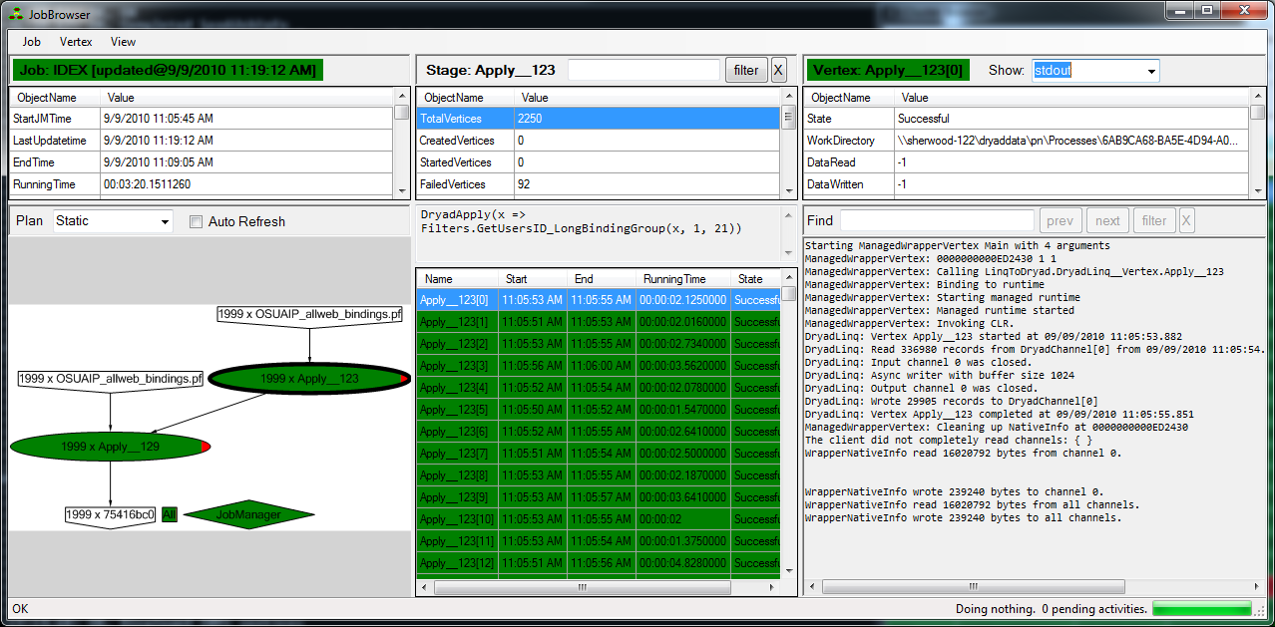
DryadLINQ job browser

Slide 89
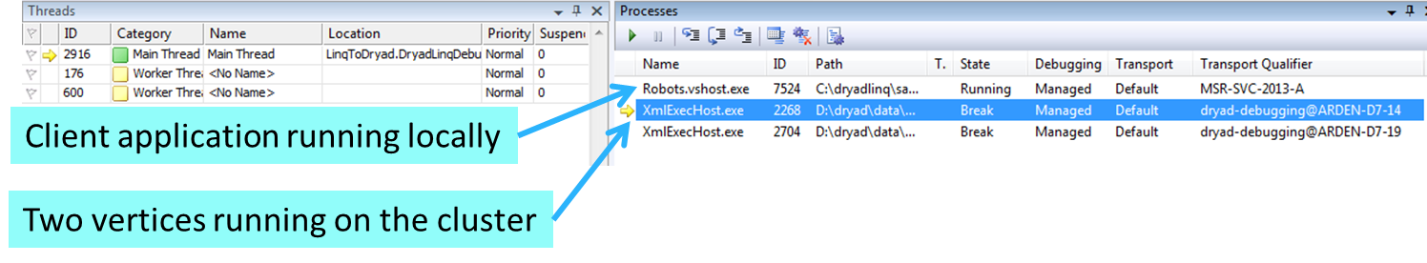
Debugging
Integrated with the Visual Studio Debugger
Debug vertices from the local machine

Slide 90
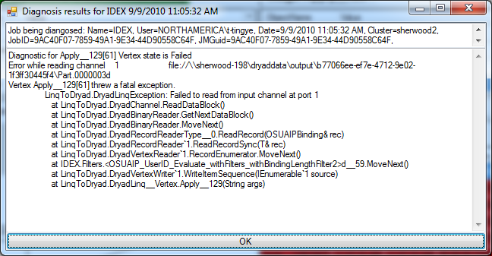
Automated Failure Diagnostics

Slide 91
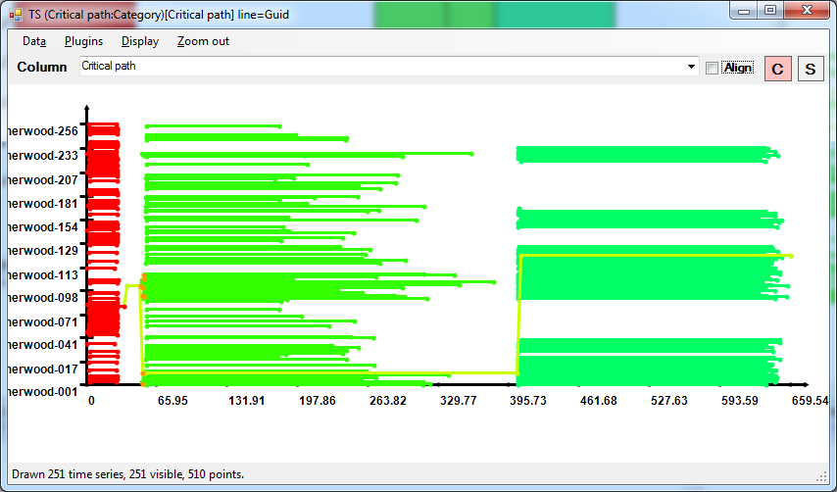
Job statistics: schedule and critical path

Slide 92
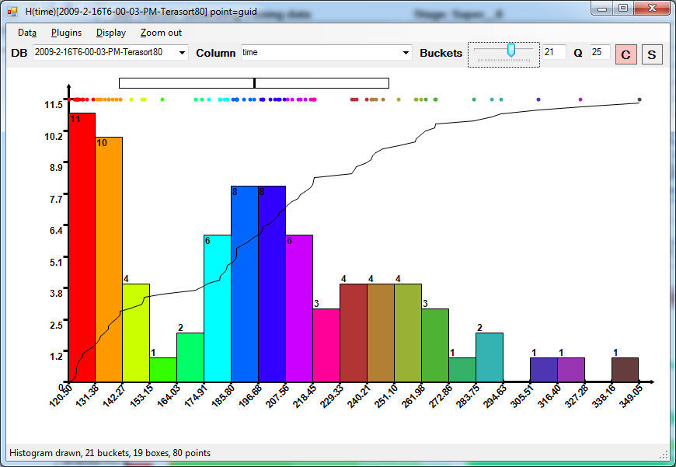
Running time distribution

Slide 93
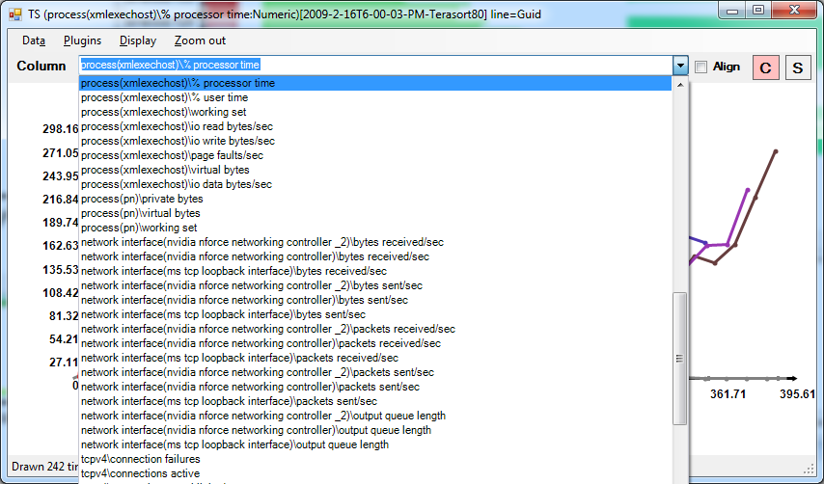
Performance counters

Slide 94
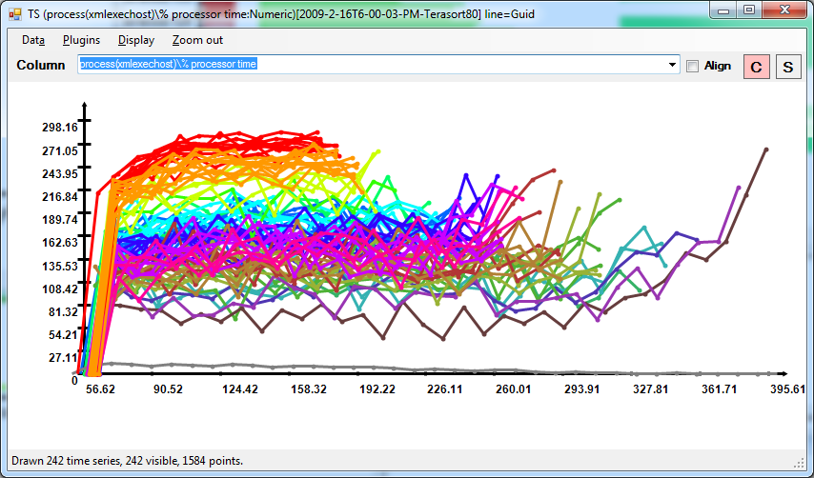
CPU Utilization

Slide 95
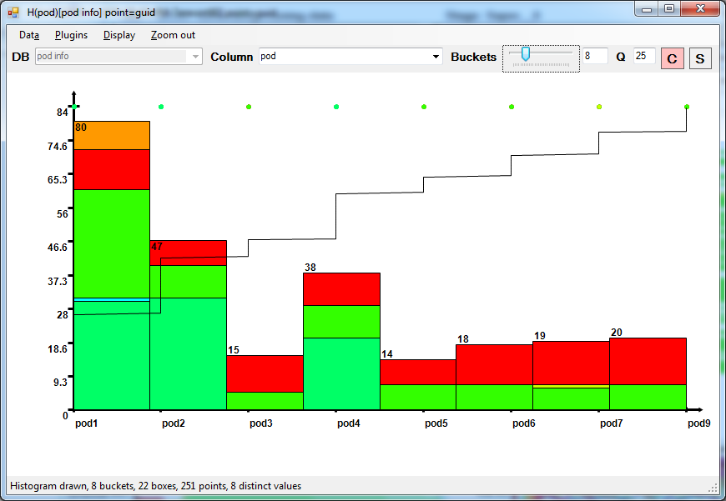
Load imbalance: rack assignment

Slide 96

So, What Good is it For?

Slide 97

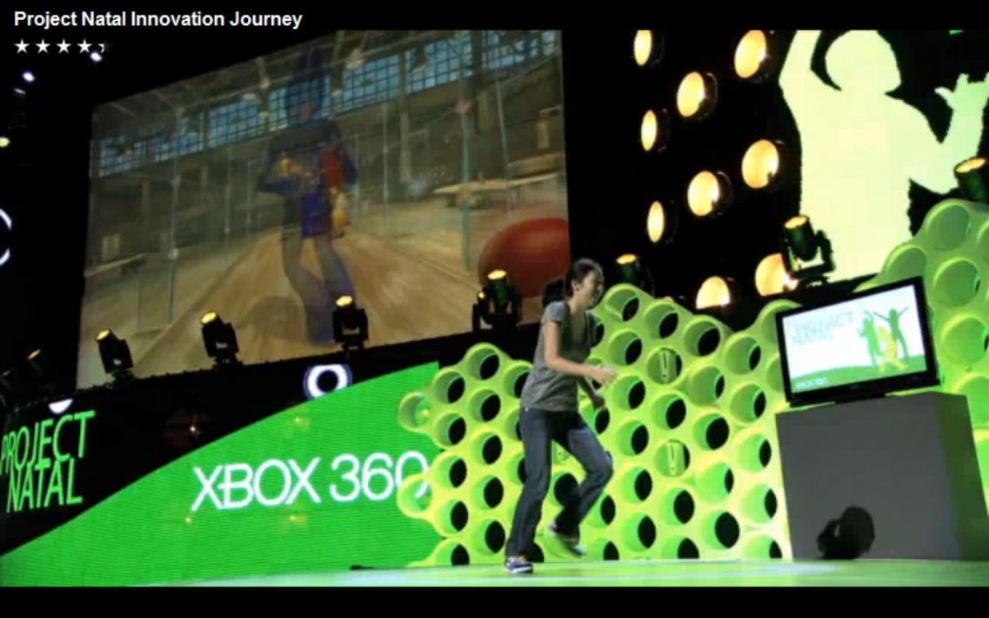
Application: Kinect Training

Slide 98
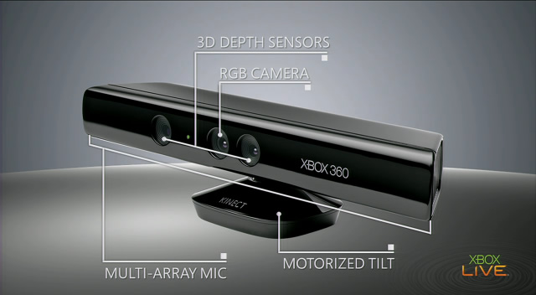
Input device

Slide 99


Vision Input: Depth Map + RGB

Slide 100
Vision Problem: What is a human
Recognize players from depth map
At frame rate
Minimal resource usage
Notes:
Image from http://r24085.ovh.net/images/Gallery/depthMap-small.jpg

Slide 101



Learn from Data
Rasterize
Motion Capture
(ground truth)
Training examples
Machine learning
Classifier

Slide 102
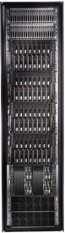
Learning from data
Classifier
Training examples
(millions of frames)
Machine learning
DryadLINQ
Dryad

Slide 103
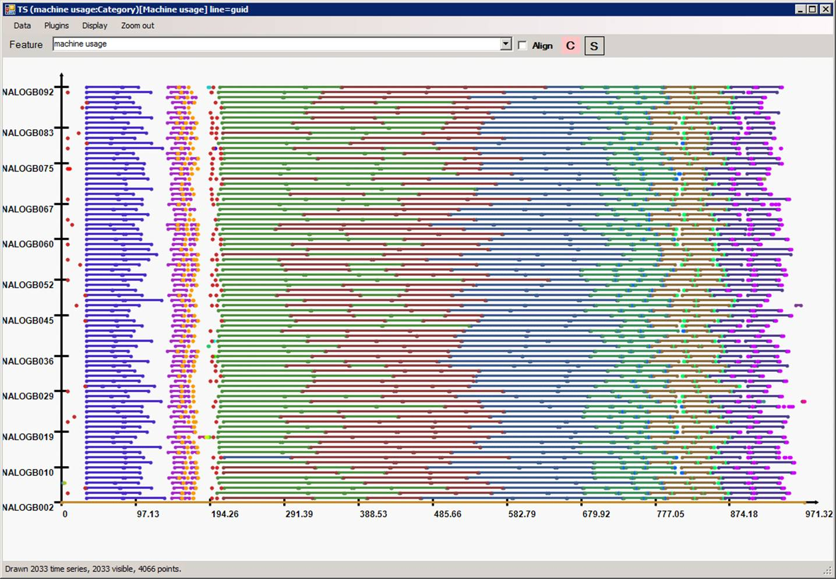
Highly efficient parallellization

Slide 104
The End

Slide 105
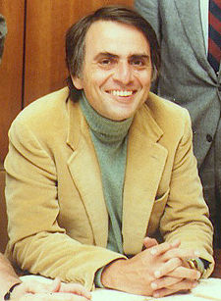



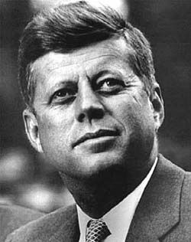
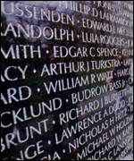
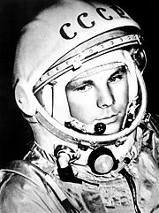

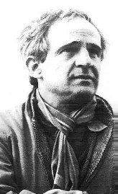




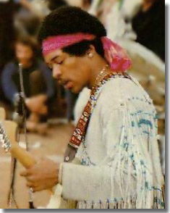

The Roaring ‘60s

Slide 106
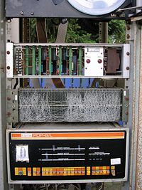
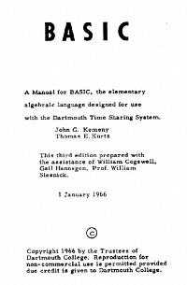

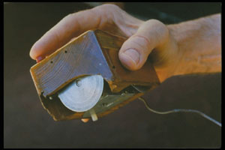
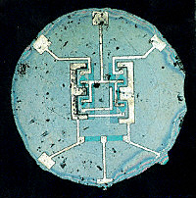

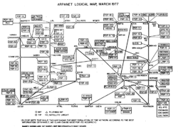
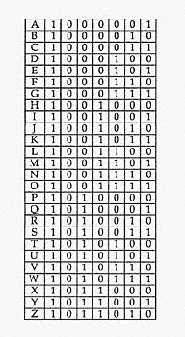

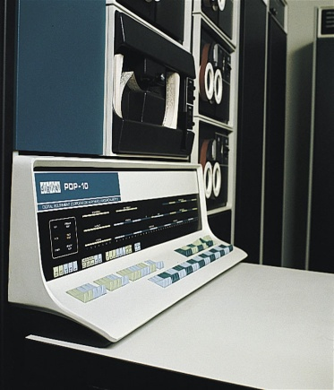
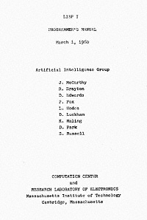
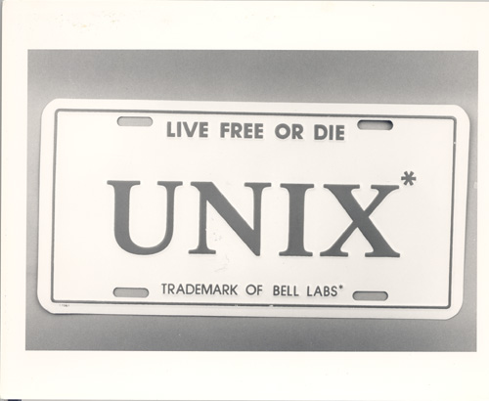
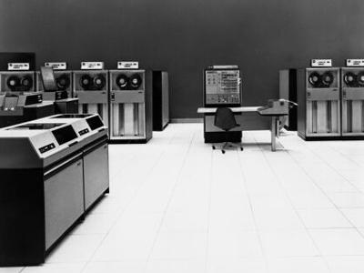
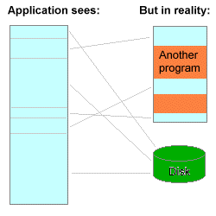
The other ‘60s
Spacewars
PDP/8
ARPANET
Multics
Time-sharing
(defun factorial (n)
(if (<= n 1) 1
(* n (factorial (- n 1)))))
Virtual memory
OS/360

Slide 107
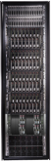


What about the 2010’s?

Slide 108
Layers
Applications
Programming Languages and APIs
Resource Management
Scheduling
Distributed Execution
Operating System
Caching and Synchronization
Storage
Identity & Security
Networking

Slide 109









Pieces of the Global Computer
And many, many more…

Slide 110
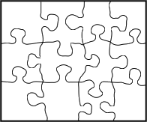
This lecture

Slide 111


The cloud
“The cloud” is evolving rapidly
New frontiers are being conquered
The face of computing will change forever
There is still a lot to be done
You might do it!

Slide 112
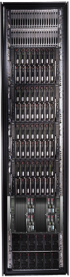
Conclusions
Cluster
LINQ
Dryad
=
112
Notes:
We believe that Dryad and DryadLINQ are a great foundation for cluster computing.

Slide 113
Bibliography (1)
Dryad: Distributed Data-Parallel Programs from Sequential Building Blocks
Michael Isard, Mihai Budiu, Yuan Yu, Andrew Birrell, and Dennis Fetterly
European Conference on Computer Systems (EuroSys), Lisbon, Portugal, March 21-23, 2007
DryadLINQ: A System for General-Purpose Distributed Data-Parallel Computing Using a High-Level Language
Yuan Yu, Michael Isard, Dennis Fetterly, Mihai Budiu, Úlfar Erlingsson, Pradeep Kumar Gunda, and Jon Currey Symposium on Operating System Design and Implementation (OSDI), San Diego, CA, December 8-10, 2008
Hunting for problems with Artemis Gabriela F. Creţu-Ciocârlie, Mihai Budiu, and Moises Goldszmidt USENIX Workshop on the Analysis of System Logs (WASL), San Diego, CA, December 7, 2008
DryadInc: Reusing work in large-scale computations Lucian Popa, Mihai Budiu, Yuan Yu, and Michael Isard Workshop on Hot Topics in Cloud Computing (HotCloud), San Diego, CA, June 15, 2009
Distributed Aggregation for Data-Parallel Computing: Interfaces and Implementations,
Yuan Yu, Pradeep Kumar Gunda, and Michael Isard,
ACM Symposium on Operating Systems Principles (SOSP), October 2009
Quincy: Fair Scheduling for Distributed Computing Clusters
Michael Isard, Vijayan Prabhakaran, Jon Currey, Udi Wieder, Kunal Talwar, and Andrew Goldberg ACM Symposium on Operating Systems Principles (SOSP), October 2009

Slide 114
Bibliography (2)
Autopilot: Automatic Data Center Management, Michael Isard, in Operating Systems Review, vol. 41, no. 2, pp. 60-67, April 2007
Distributed Data-Parallel Computing Using a High-Level Programming Language, Michael Isard and Yuan Yu, in International Conference on Management of Data (SIGMOD), July 2009
SCOPE: Easy and Efficient Parallel Processing of Massive Data Sets Ronnie Chaiken, Bob Jenkins, Per-Åke Larson, Bill Ramsey, Darren Shakib, Simon Weaver, and Jingren Zhou, Very Large Databases Conference (VLDB), Auckland, New Zealand, August 23-28 2008
Incorporating Partitioning and Parallel Plans into the SCOPE Optimizer, Jingren Zhou, Per-Åke Larson, and Ronnie Chaiken, in Proc. of the 2010 ICDE Conference (ICDE’10).
Nectar: Automatic Management of Data and Computation in Data Centers, Pradeep Kumar Gunda, Lenin Ravindranath, Chandramohan A. Thekkath, Yuan Yu, and Li Zhuang, in Proc. USENIX Symposium on Operating Systems Design and Implementation (OSDI ‘10), October 2010, Vancouver, BC, Canada.

